Slide 1
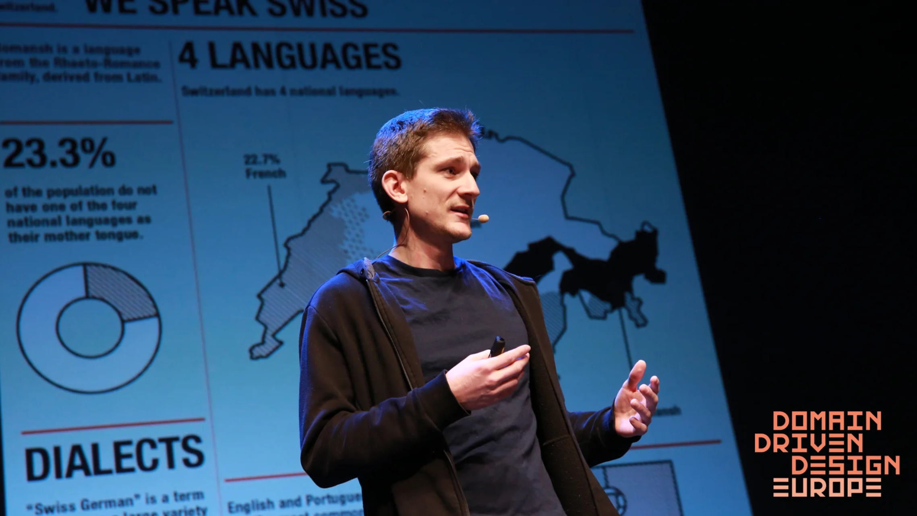


Share Pie: The DDD Treasure Hidden in Plain Sight
Tuesday July 5th 2022
19h30
#DDDFR
Nick Tune (independent consultant)

